Slide 1
Understanding Faster R-CNN

Slide 2
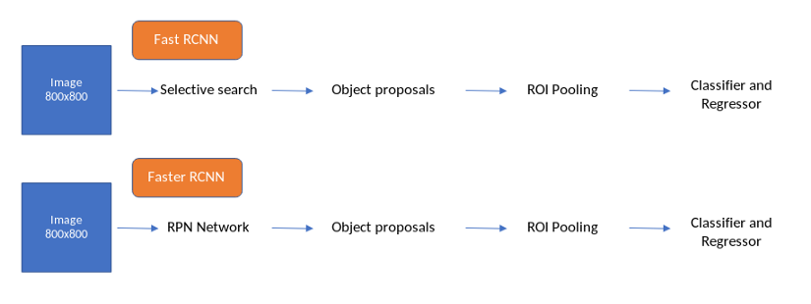
Faster R-CNN
Faster R-CNN is one of the first frameworks which completely works on Deep learning. It is built upon the knowledge of Fast RCNN which indeed built upon the ideas of RCNN and SPP-Net.

Slide 3
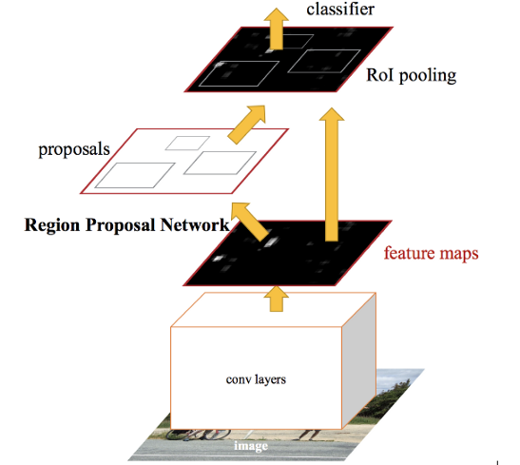
Faster R-CNN fixes the problem of selective search by replacing it with Region Proposal Network (RPN). We first extract feature maps from the input image using ConvNet and then pass those maps through a RPN which returns object proposals. Finally, these maps are classified and the bounding boxes are predicted.

Slide 4
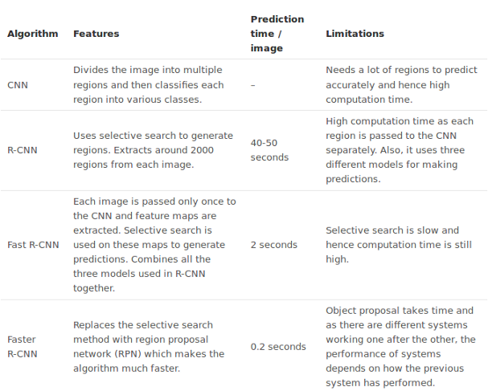

Slide 5
Building Faster R-CNN from Scratch
Take an input image and pass it to the ConvNet which returns feature maps for the image
Apply Region Proposal Network (RPN) on these feature maps and get object proposals
Apply ROI pooling layer to bring down all the proposals to the same size
Finally, pass these proposals to a fully connected layer in order to classify any predict the bounding boxes for the image

Slide 6
The flow
The usual data flow in Faster R-CNN when training the network is as written below
Features Extraction from the image.
Creating anchor targets.
Locations and objectness score prediction from the RPN network.
Taking the top N locations and their objectness scores aka proposal layer
Passing these top N locations through Fast R-CNN network and generating locations and cls predictions for each location is suggested in 4.

Slide 7
generating proposal targets for each location suggested in 4
Using 2 and 3 to calculate rpn_cls_loss and rpn_reg_loss.
using 5 and 6 to calculate roi_cls_loss and roi_reg_loss.
We will configure VGG16 and use it as the back-end in this experiment.

Slide 8
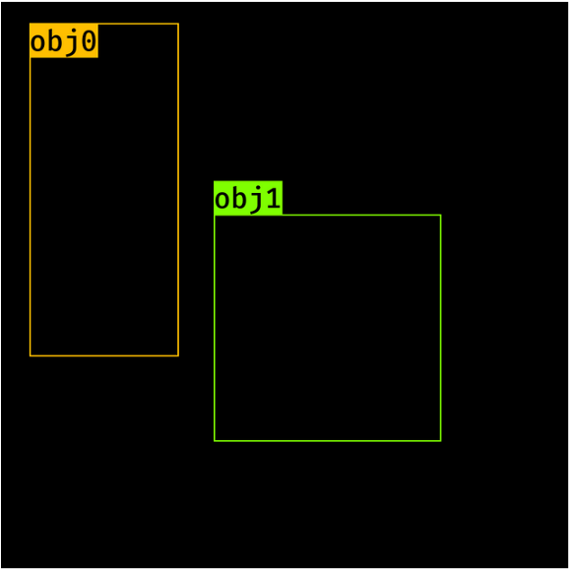
Feature Extraction
The VGG16 network is used as a feature extraction module here, This acts as a backbone for both the RPN network and Fast_R-CNN network. We need to make a few changes to the VGG network inorder to make this work.
Output image size = Input Image size/sub-sample
So we need to check here the VGG16 module is achieving this feature map size and trim the network

Slide 9
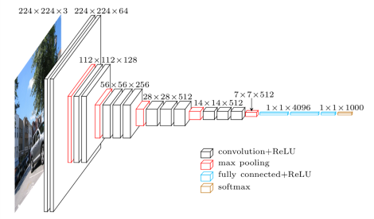
VGG16 Architecture

Slide 10
RPN
Take an input image of 800x800 and send it to the network.
For a VGG Network, after subsampling ratio of 16, the output will be [512, 50, 50].
An RPN network is applied on this feature map, which generates (50*50*9) boxes regression and classification scores.
So regression output is 50*50*9*4 (x,y, w, h) and classification output is 50*50*9*2 (object present or not).
Here 9 implies the number of anchor boxes at each location.

Slide 11
Anchor boxes
Generate Anchor at a feature map location
Generate Anchor at all the feature map location.
Assign the labels and location of objects (with respect to the anchor) to each and every anchor.
Generate Anchor at a feature map location

Slide 12
At each location, we have 9 anchor boxes, and they have different scales and aspect ratios. The following are defined
At feature map location 1,1 is mapped to [0, 0, 16, 16] box on the image. this has center at 8, 8. Now we need to draw the 9 anchor boxes using the above scales and ratios.
anchors_boxes_per_location = 9
scales = [8, 16, 32]
ratios = [0.5, 1, 2]
ctr_x, ctr_y = 16/2, 16/2 [at (1,1) location)

Slide 13
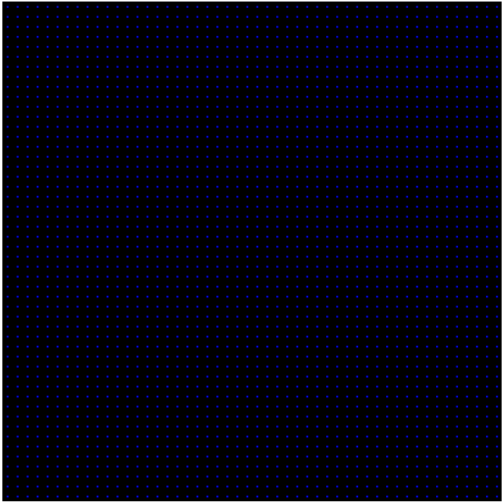
Scales:
128*128, 256*256, 512*512
Ratios:
1:1, 1:2, 2:1
Image representing all the image centers (50*50).
Since there are 50*50 anchor centers and each one has 9 anchors. in total we get 22500 anchors.

Slide 14
Anchor at One Location
anchor_base = np.zeros((len(ratios) * len(scales), 4), dtype=np.float32)
print(anchor_base)
for i in range(len(ratios)):
for j in range(len(anchor_scales)):
h = sub_sample * anchor_scales[j] * np.sqrt(ratios[i])
w = sub_sample * anchor_scales[j] * np.sqrt(1./ ratios[i])
index = i * len(anchor_scales) + j
anchor_base[index, 0] = ctr_y - h / 2.
anchor_base[index, 1] = ctr_x - w / 2.
anchor_base[index, 2] = ctr_y + h / 2.
anchor_base[index, 3] = ctr_x + w / 2.
Out:
array([[0., 0., 0., 0.],
[0., 0., 0., 0.],
[0., 0., 0., 0.],
[0., 0., 0., 0.],
[0., 0., 0., 0.],
[0., 0., 0., 0.],
[0., 0., 0., 0.],
[0., 0., 0., 0.],
[0., 0., 0., 0.]], dtype=float32)
Out:
array([[ -37.254833, -82.50967 , 53.254833, 98.50967 ],
[ -82.50967 , -173.01933 , 98.50967 , 189.01933 ],
[-173.01933 , -354.03867 , 189.01933 , 370.03867 ],
[ -56. , -56. , 72. , 72. ],
[-120. , -120. , 136. , 136. ],
[-248. , -248. , 264. , 264. ],
[ -82.50967 , -37.254833, 98.50967 , 53.254833],
[-173.01933 , -82.50967 , 189.01933 , 98.50967 ],
[-354.03867 , -173.01933 , 370.03867 , 189.01933 ]],
dtype=float32)

Slide 15
Anchors for all locations
fe_size = 50
anchors = np.zeros((fe_size * fe_size * 9), 4)
index = 0
for c in ctr:
ctr_y, ctr_x = c
for i in range(len(ratios)):
for j in range(len(anchor_scales)):
h = sub_sample * anchor_scales[j] * np.sqrt(ratios[i])
w = sub_sample * anchor_scales[j] * np.sqrt(1./ ratios[i])
anchors[index, 0] = ctr_y - h / 2.
anchors[index, 1] = ctr_x - w / 2.
anchors[index, 2] = ctr_y + h / 2.
anchors[index, 3] = ctr_x + w / 2.
index += 1
print(anchors.shape)
#Out: [22500, 4]

Slide 16
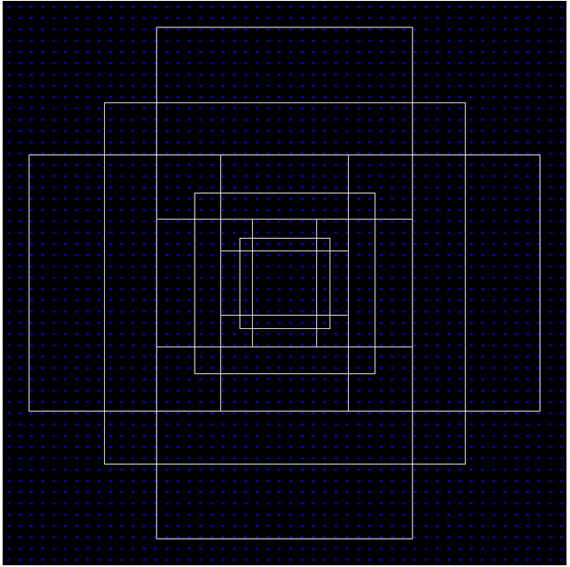
Anchor boxes at (400,400)
Scales:
128*128, 256*256, 512*512
Ratios:
1:1, 1:2, 2:1

Slide 17
RPN Network
So the RPN produces object proposals wrt to each anchor box along with their objectness score. An anchor box is assigned +ve if it has max_iou with the ground truth object or iou greater than 0.7. An anchor box is assigned negative if it has iou < 0.4. All the anchor boxes with iou [0.4, 0.7] are ignored. Anchor boxes which fall outside the image are also ignored.
Again, since vast majority of them will have negative samples, we will use the same Fast R-CNN strategy to sample 128+ve samples and 128-ve samples (total 256) for a batch size of 2 for training.
Smooth L1 loss and cross entropy loss can be used for regression and classification. Regression outputs are offset with anchor box locations using the following formulae

Slide 18
x, y , w, h are the ground truth box center co-ordinates, width and height.
x_a, y_a, h_a and w_a are anchor boxes center cooridinates, width and height.
t_{x} = (x - x_{a})/w_{a}
t_{y} = (y - y_{a})/h_{a}
t_{w} = log(w/ w_a)
t_{h} = log(h/ h_a)

Slide 19
Once RPN outputs are generated, we need to process them before sending to the RoI pooling layer (aka fast R-CNN network) . The Faster R_CNN says, RPN proposals highly overlap with each other. To reduced redundancy, we adopt non-maximum supression (NMS) on the proposal regions based on their cls scores. We fix the IoU threshold for NMS at 0.7, which leaves us about 2000 proposal regions per image. After an ablation study, the authors show that NMS does not harm the ultimate detection accuracy, but substantially reduces the number of proposals. After NMS, we use the top-N ranked proposal regions for detection. In the following we training Fast R-CNN using 2000 RPN proposals. During testing they evaluate only 300 proposals, they have tested this with various numbers and obtained this.

Slide 20
nms_thresh = 0.7
n_train_pre_nms = 12000
n_train_post_nms = 2000
n_test_pre_nms = 6000
n_test_post_nms = 300
min_size = 16
Once the ~2000 proposals are generated, these are transformed using the following formulas
Now these 2000 proposals are similar to the proposals generated by selective search in Fast R-CNN. So the rest of the process is similar to Fast R-CNN.
x = (w_{a} * ctr_x_{p}) + ctr_x_{a}
y = (h_{a} * ctr_x_{p}) + ctr_x_{a}
h = np.exp(h_{p}) * h_{a}
w = np.exp(w_{p}) * w_{a}
and later convert to y1, x1, y2, x2 format

Slide 21
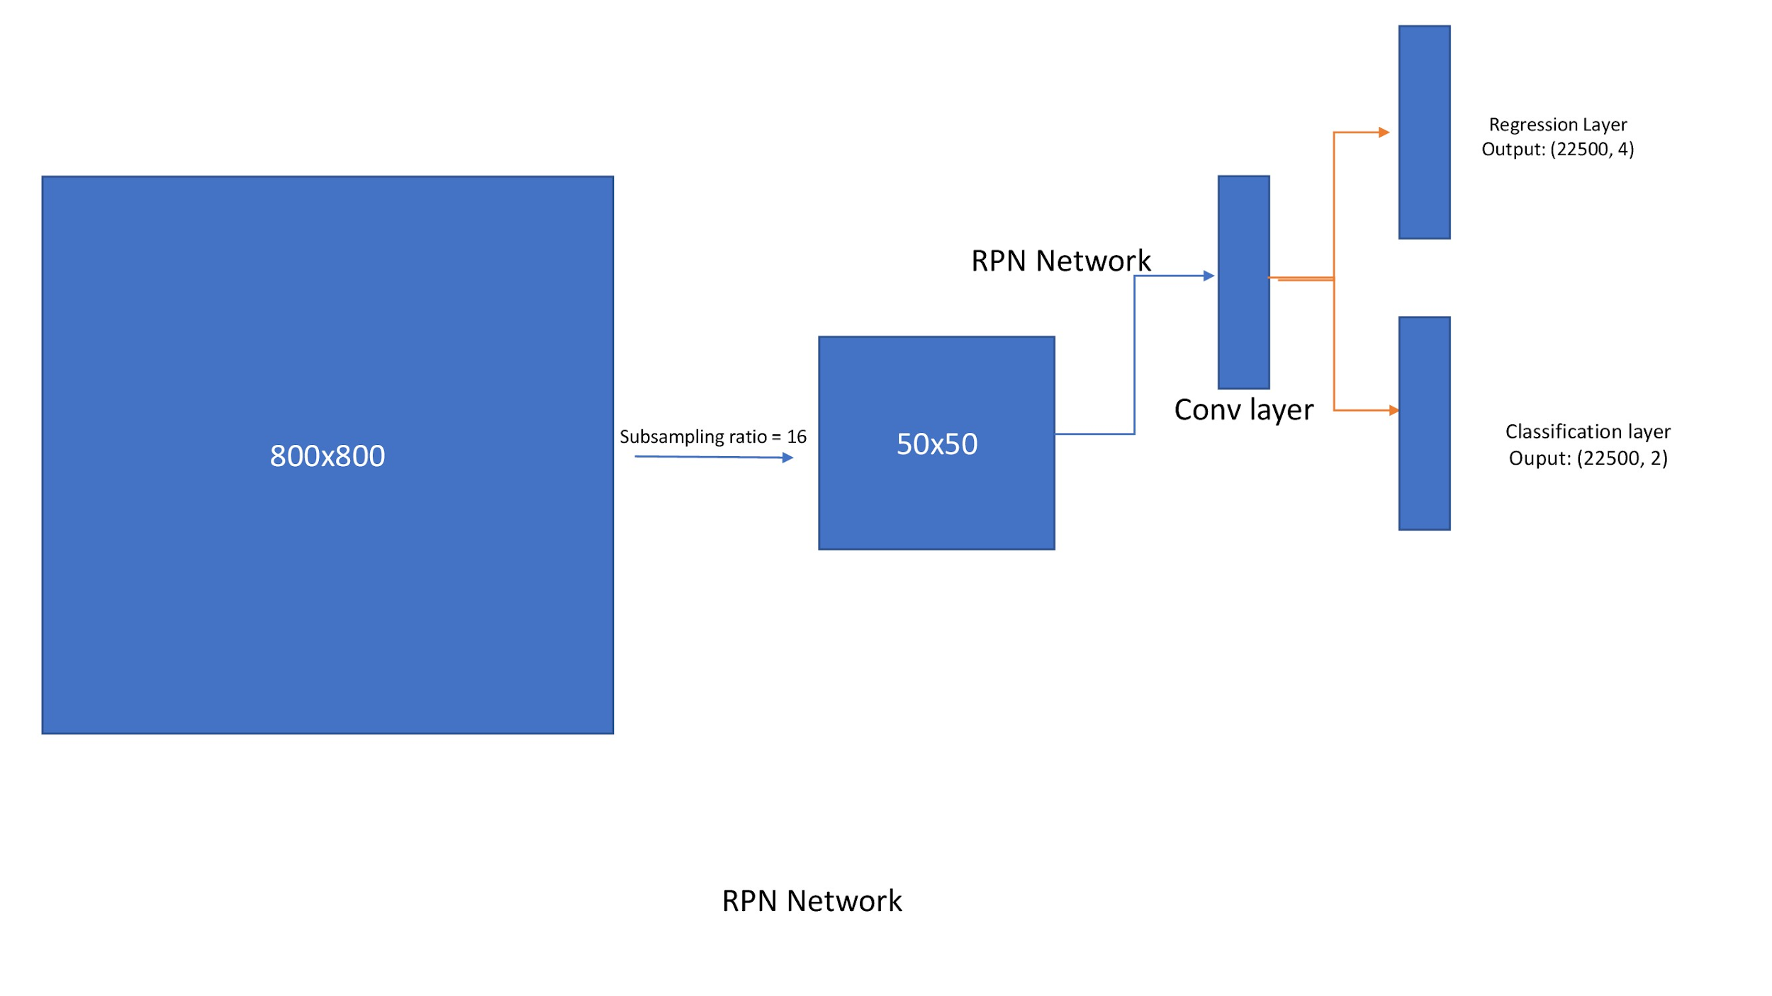

Slide 22
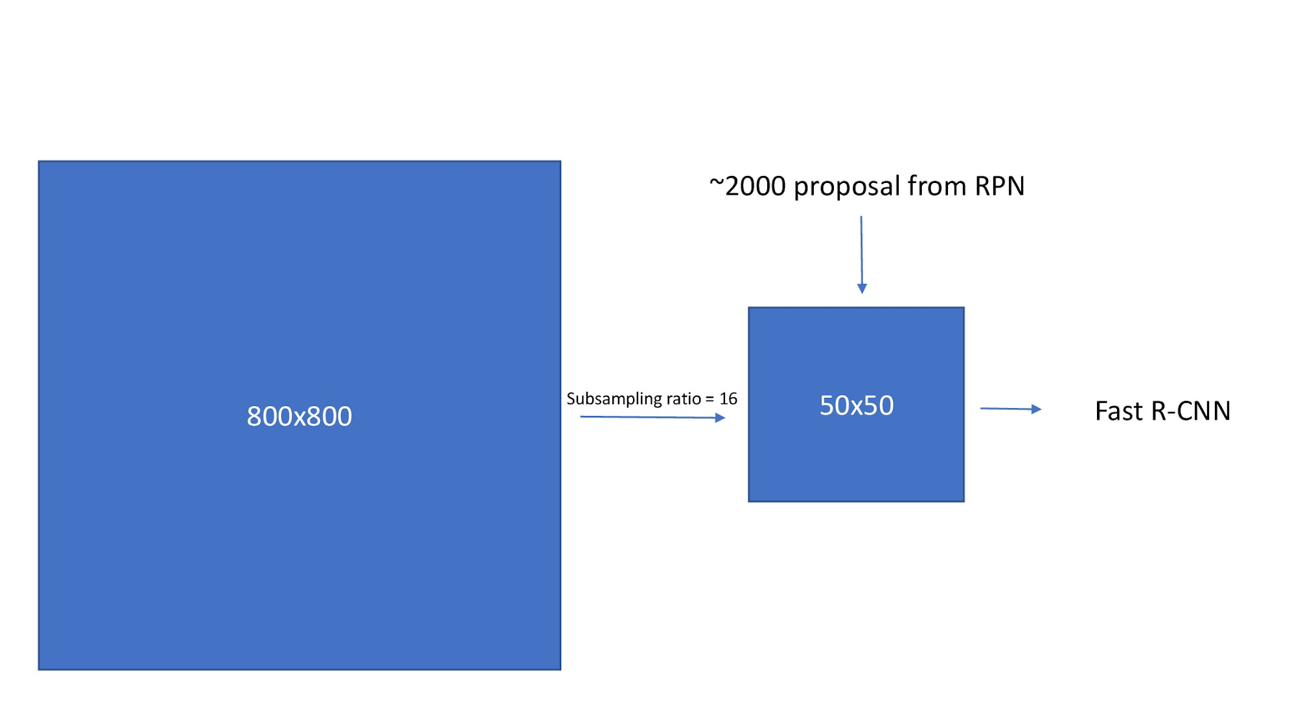

Slide 23
Fast R-CNN
The network processes the whole image to produce a convolutional feature map. Then for each object proposal ROI pooling layer extracts fixed-length feature vector, which is finally passed to subsequent FC layers.
The FC layers branch into two sibling output layers, one that estimates softmax probability over K+1 object classes, and another layer producing the refined bounding box positions.
2000 proposals of particular image are not passed through the network as in R-CNN. Instead, The image is passed only once and the computed features are shared across ~2000 proposals.

Slide 24
Also, the ROI pooling layer does max pooling in each sub-window of approximate size h/H X w/W. H and W are hyper-parameters. It is a special case of SPP layer with one pyramid level.
The two sibling output layers’ outputs are used to calculate a multi-task loss on each labeled ROI to jointly train for classification and bounding-box regression.
They have used L1 loss for bounding box regression as opposed to L2 loss in R-CNN and SPP-Net which is more sensitive to outliers.

Slide 25
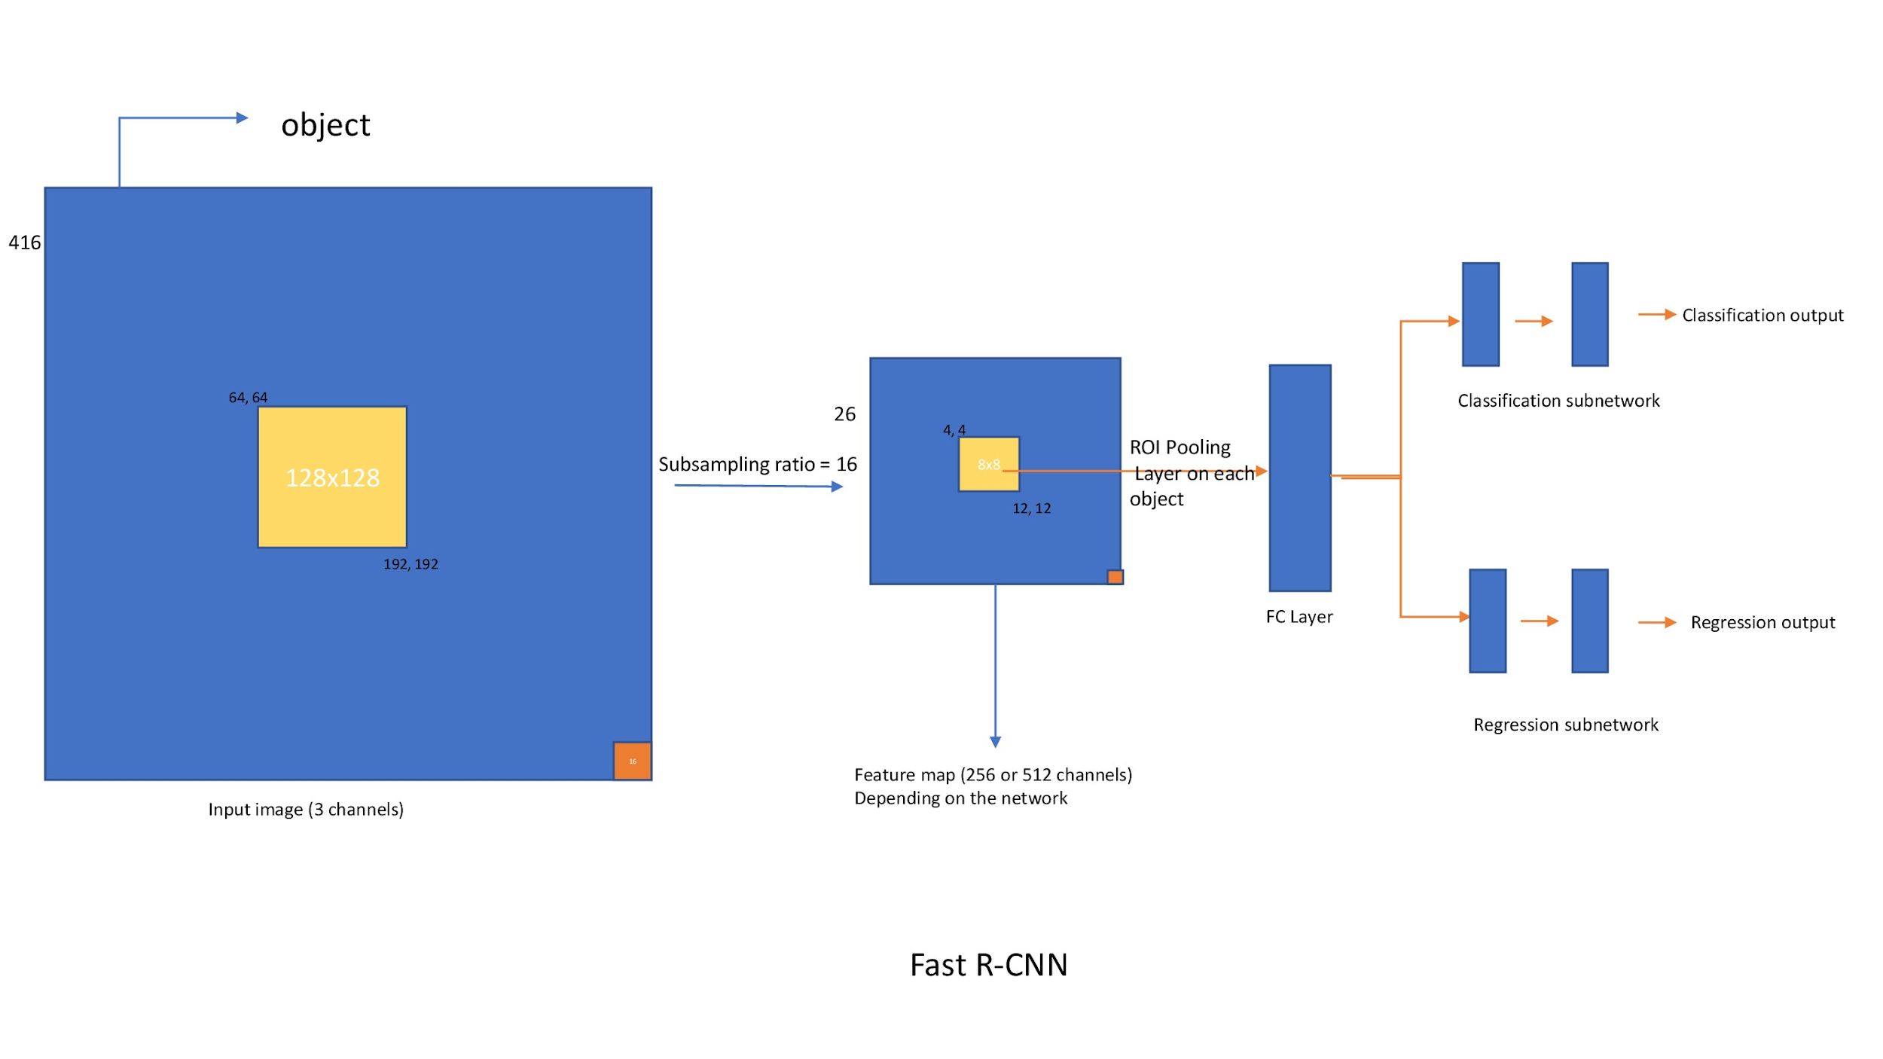

Slide 26
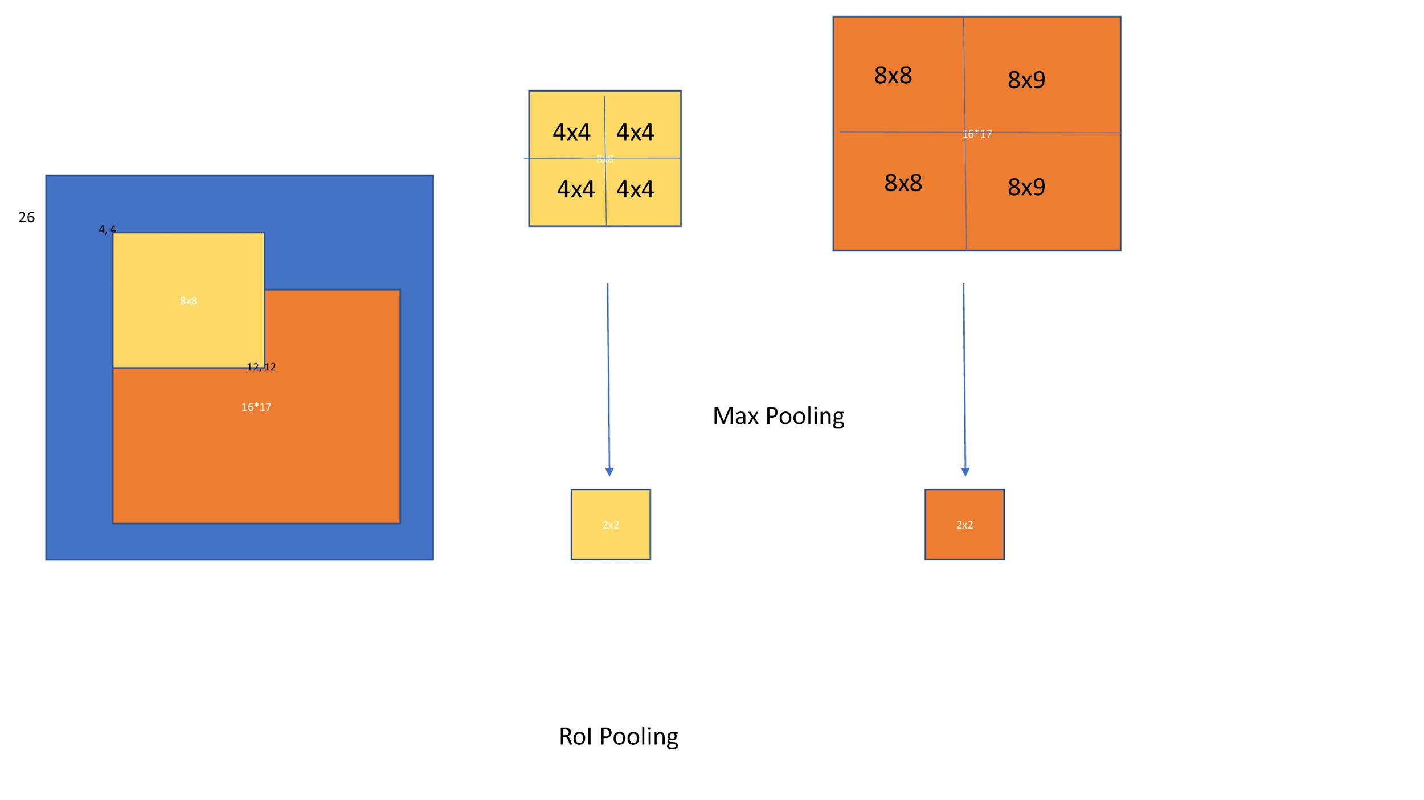

Slide 27
Loss Functions
The Fast R-CNN network has two sibling networks as discussed above, the classification layer outputs discrete probability scores and the regression layer outputs offsets of x, y, w, h values of the object. For classification we can use cross entropy loss. for regression they use smooth L1 loss.

Slide 28
Training
While training Fast R-CNN uses batch size of 2. Since for a batch size of 2 we have ~2000 x 2 = 4000 boxes and majority of them won’t contain the object, there will be extreme class imbalance while training this network. For this sake, we randomly sample 64 +ve boxes and 64 -ve boxes from the ~4000 boxes and compute losses only for these boxes. Incase if we have less +ve boxes, we will pad with negative boxes. In total we will have 128 boxes for each iteration. The same approach is used in Faster R-CNN also.
A Proposal is said to be foreground if it has iou > 0.5 with any of the bounding box, we will assign class to the proposal accordingly. proposals which has [0.1, 0.5) are termed to be negative. Remaining all proposals are ignored

Slide 29
Mask R-CNN
Idea: Can we extend such techniques to go one step further and locate exact pixels of each object instead of just bounding boxes?
Mask R-CNN does this by adding a branch to Faster R-CNN that outputs a binary mask that says whether or not a given pixel is part of an object. The branch (in white in the above image), as before, is just a Fully Convolutional Network on top of a CNN based feature map. Here are its inputs and outputs:
Inputs: CNN Feature Map.
Outputs: Matrix with 1s on all locations where the pixel belongs to the object and 0s elsewhere (this is known as a binary mask).

Slide 30
When run without modifications on the original Faster R-CNN architecture, the Mask R-CNN authors realized that the regions of the feature map selected by RoIPool were slightly misaligned from the regions of the original image. Since image segmentation requires pixel level specificity, unlike bounding boxes, this naturally led to inaccuracies.

Slide 31
RoI Align
This problem by cleverly adjusting RoIPool to be more precisely aligned using RoIAlign. In RoIPool, we would round this down and select 2 pixels causing a slight misalignment. However, in RoIAlign, we avoid such rounding. Instead, we use bilinear interpolation to get a precise idea of what would be at pixel 2.93. This, at a high level, is what allows us to avoid the misalignments caused by RoIPool.
Once these masks are generated, Mask R-CNN combines them with the classifications and bounding boxes from Faster R-CNN to generate such wonderfully precise segmentation

Slide 32
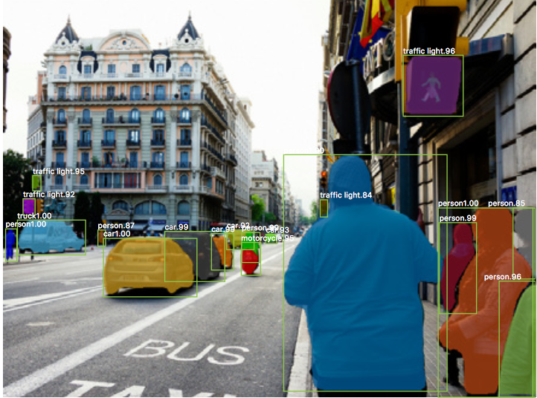

Slide 33
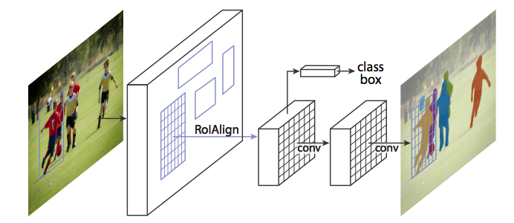

Slide 34
Future Plan (Phase-1)
Object detection (done)
Region Proposals (done)
R-CNN, Fast R-CNN (done)
Faster R-CNN (Read Base Paper) (done)
Get Familiar with PASCAL VOC (done)
Read about VGG network (done)
Understand Code for Faster R-CNN (done)
Mask R-CNN
Understand Mask R-CNN code

